Slide 1


AEGIS Git GUI Source Control
Connor Savugot
Summer 2025
Notes:
We have more content to go through than time to go through it.
I will keep it short. There’s an accompanying markdown document and PDF that’s about 90 pages long.
Please follow the documentation to set up an environment like mine today, if you have time.
I will be on vacation in Spain all next week, so set it up today if you can.
If you have questions, please interrupt me at anytime.
Mention Git Lab vs Git Hub

Slide 2


Overview
Purpose of using Git
Basic Terminology
Markdown/PDF Overview
AEGIS Development Workflow
Git Lab Repository
Notes:
Git Lab Repository - http://gitlab01.local/csavugot/GitSrcCtrl_GUI
Repo contains all of the documentation and files for this project.

Slide 3
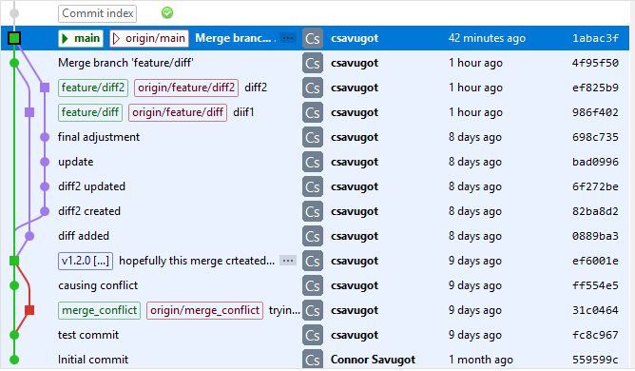
Git Abilities
Tracks file changes over time
Undo mistakes by returning to a previous version
Allows multiple people work together
Keeps a full project history
Supports safe experimentation with branches
Notes:
Tracks file changes over time
Git keeps a record of every change made to your files — not just the latest version. That means you can see how the project evolved and who made what change, even months ago.
Undo mistakes by returning to a previous version
If you make a mistake or something breaks, you’re not stuck. Git lets you roll back to an earlier version.
Allows multiple people work together
Everyone on the team can make changes at the simultaneously. Git helps merge everyone’s contributions safely.
Keeps a full project history
You can see what’s been done, when, and by who.
Supports safe experimentation with branches
Git lets you create a separate "branch" to test new features or fixes without affecting the main code. Once it's working, you can merge it back in.

Slide 4
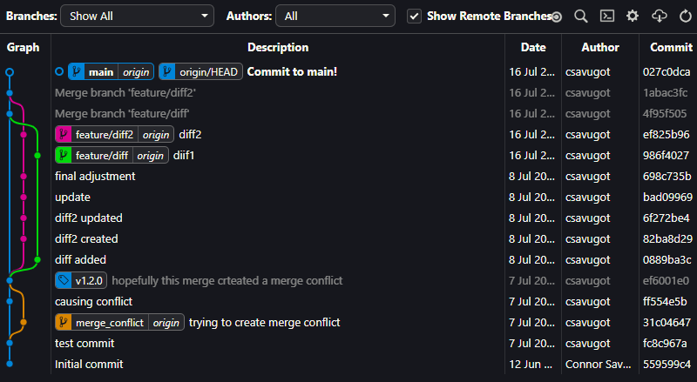
Basic Git Terminology
Repository (Repo)
Remote
Local
Branch
GUI
Tag
Commit Message
Notes:
Repository (repo)
Folder Uploaded to GitLabs containing all code for a given project. May contain any file type, so you can also store documentation here.
Remote repo
The version of a repo stored on a git server accessible via URL. Opposite of Local
Local repo
The version of a repo stored on your computer accessible via file explorer. Opposite of Remote
Branch
A separate version of your code used to develop new features or test changes without affecting the main project. Changes are merged into other branches when ready.
GUI
Graphical User Interface. The opposite of a command line interface. Think buttons and icons instead of typing commands into a terminal.
Tag
A snapshot used to mark official versions of the code (e.g., v1.0). Used to label production releases.
Commit Message
A short description you write when saving changes (a “commit”). It explains what you did and helps others understand your work.
Commit Hash
A unique ID automatically assigned to each commit. Used to track or refer to specific changes.

Slide 5
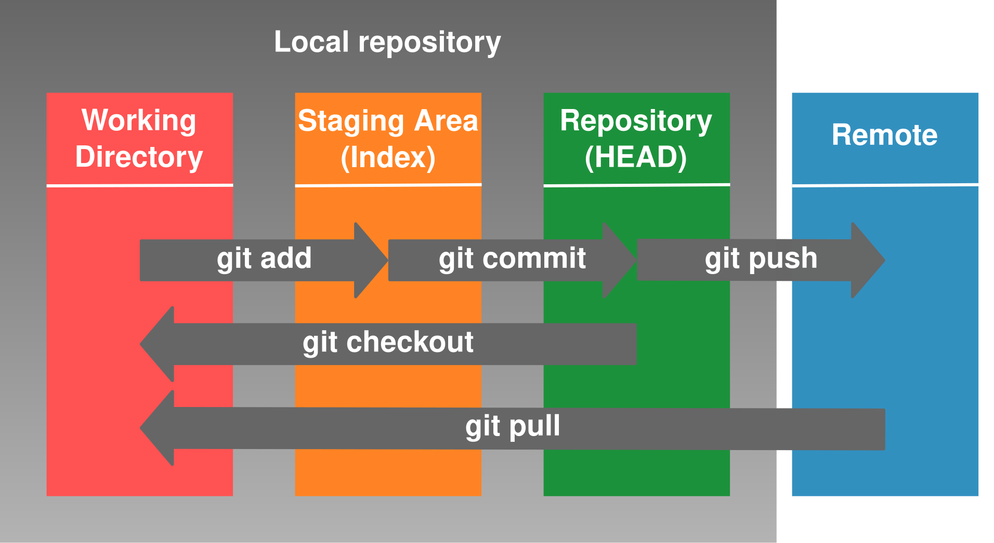
Basic Git Actions
Stage (add)
Commit
Push
Pull
Fetch
Checkout
Notes:
Stage (add)
Marks files to be included in your next commit. Like packing items into a box before sealing it.
Commit
Saves a snapshot of staged changes to your local repo with a short message explaining what changed.
Push
Sends your commits from the local repo to the remote repo so others can see them.
Pull
Gets the latest changes from the remote repo and merges them into your local repo.
Fetch
Downloads the latest changes from the remote repo, but does not apply them to your local branch yet.
Checkout
Switches your current branch or file version. Think of it like changing which version of the project you're looking at or editing.

Slide 6
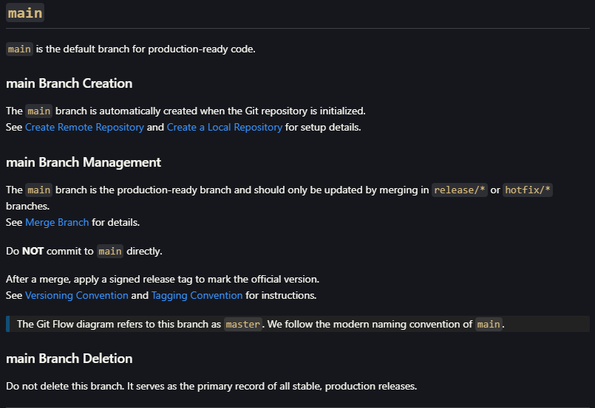
GitSrcCtrl_GUI.PDF Overview
Application Overview
Git Terminology (Extended)
Application Installation
Application Configuration
Intro to GitLabs/Git Extensions
General Git GUI Commands
AEGIS Development Workflow
Notes:
Overview
Application Overview
Git Terminology (Extended)
Application Installation
Application Configuration
Intro to GitLabs/Git Extensions
General Git GUI Commands
AEGIS Development Workflow
Document Specifications
Documentation is ~90 Pages Long.
Can be viewed as a PDF, or as Markdown within GitLab or VS Code
Stored on GitLab to be Downloaded
This is a living document. Its not finished yet. As you use it, make notes of things that are missing or suggested edits.

Slide 7
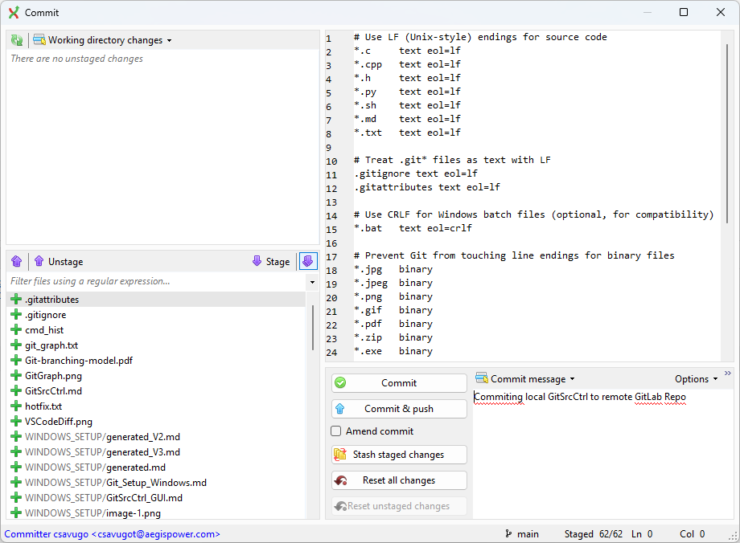
Commit Files to Remote
Open Git Extensions and click the Commit button
Stage all changes using the arrow icon
Add a commit message and click Commit & Push
Notes:
This is the recommended way to update the remote repository.
First, open Git Extensions. On the top ribbon, click the purple Commit button to begin.
You'll see a list of modified files. Click the purple multi-down-arrow icon to stage all of them for commit.
In the message box, write a short, clear description of what you changed. This is your commit message.
Finally, click Commit & push to save your changes locally and send them to the remote repository on GitLab.
Once pushed, others on your team will be able to see and pull your updates.

Slide 8
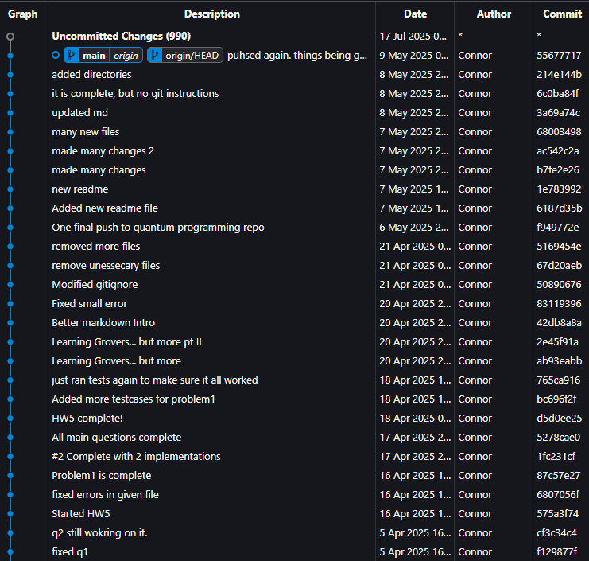
git merge --no-ff
Notes:
We use many different branches for development
Do NOT do a default merge, as this will destroy the branch history

Slide 9
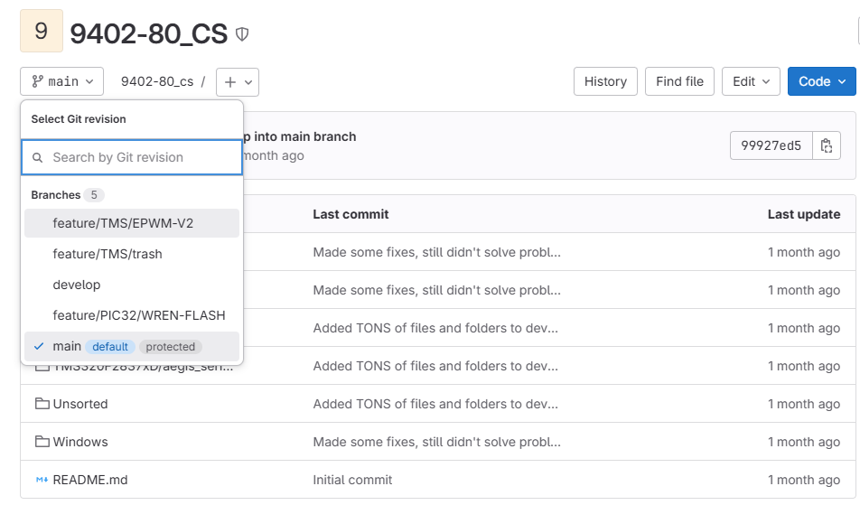
View other branches within GitLabs
Go to Repo URL
Select Correct Branch from the Dropdown
Notes:
When reviewing someone else’s work, it’s important to know which repository and which branch they’re working in.
Most development happens in feature or hardware branches — not in main — so you may not see changes unless you're on the right branch.
In GitLab, you can switch branches using the dropdown near the file view.
Just click the dropdown and select the branch you want to look at.
Always double-check that you're viewing the correct branch before reviewing code, especially during active development.

Slide 10
AEGIS Development Workflow
Git Flow Branch Summary
Branch Naming Conventions
Versioning Convention
Tagging Convention
Individual Branch Details
Notes:
Documentation covers:
Git Flow Branch Summary (GUI-Based)
Branch Naming Conventions
Versioning Convention
Tagging Convention
Individual Branch Details
Each branch type has its own development process — all related commands are linked in the GitSrc_Ctrl.md file.

Slide 11
Versioning Convention
We use semantic versioning: v<version>
Format: vX.Y (e.g., v1.0, v2.4)
X = major version (major changes, major new features)
Y = minor version (hotfixes fixes, improvements, minor features)
Each release must be tagged
Major Version Released:
v1.7 → v2.0
Minor Version Released:
v2.3 → v2.4
Notes:
We tag every official release using semantic versioning, which gives structure to how we number versions.
All tags follow the format v<version> — for example: v1.0, v2.4, and so on.
The version number has two parts:
X is the major version. We increase this when there are big changes.
Y is the minor version. We increase this for smaller updates like bug fixes, enhancements, or minor features.
When the major version (X) goes up, we reset the minor version (Y) to 0. For example: v1.7 → v2.0.
When only the minor version goes up, the major version stays the same. For example: v2.3 → v2.4.
This system helps everyone understand the impact of a release at a glance — whether it’s a big change or a small improvement.
Each production release must have a version tag, so we can track and reference stable milestones easily.

Slide 12
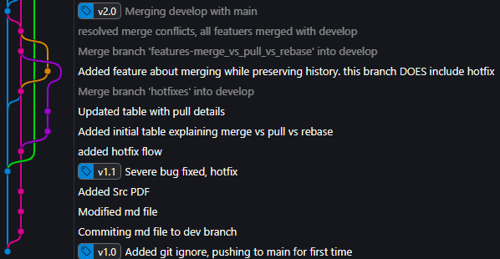
Tagging Convention
Tags mark official releases (e.g., v1.0, v2.4)
Tags are created after merging into main
Use signed, annotated tags for traceability
Format: v<version> (matches release or hotfix branch name)
Used in both release/* and hotfix/* branches
Notes:
Tags are only applied to main branch to represent a new release
We use the format v<version> — for example, v1.0, v1.1, v2.0.
All tags must be annotated and signed, which adds extra metadata like author, message, and a digital signature.
Tags are created after merging a release/* or hotfix/* branch into main.

Slide 13
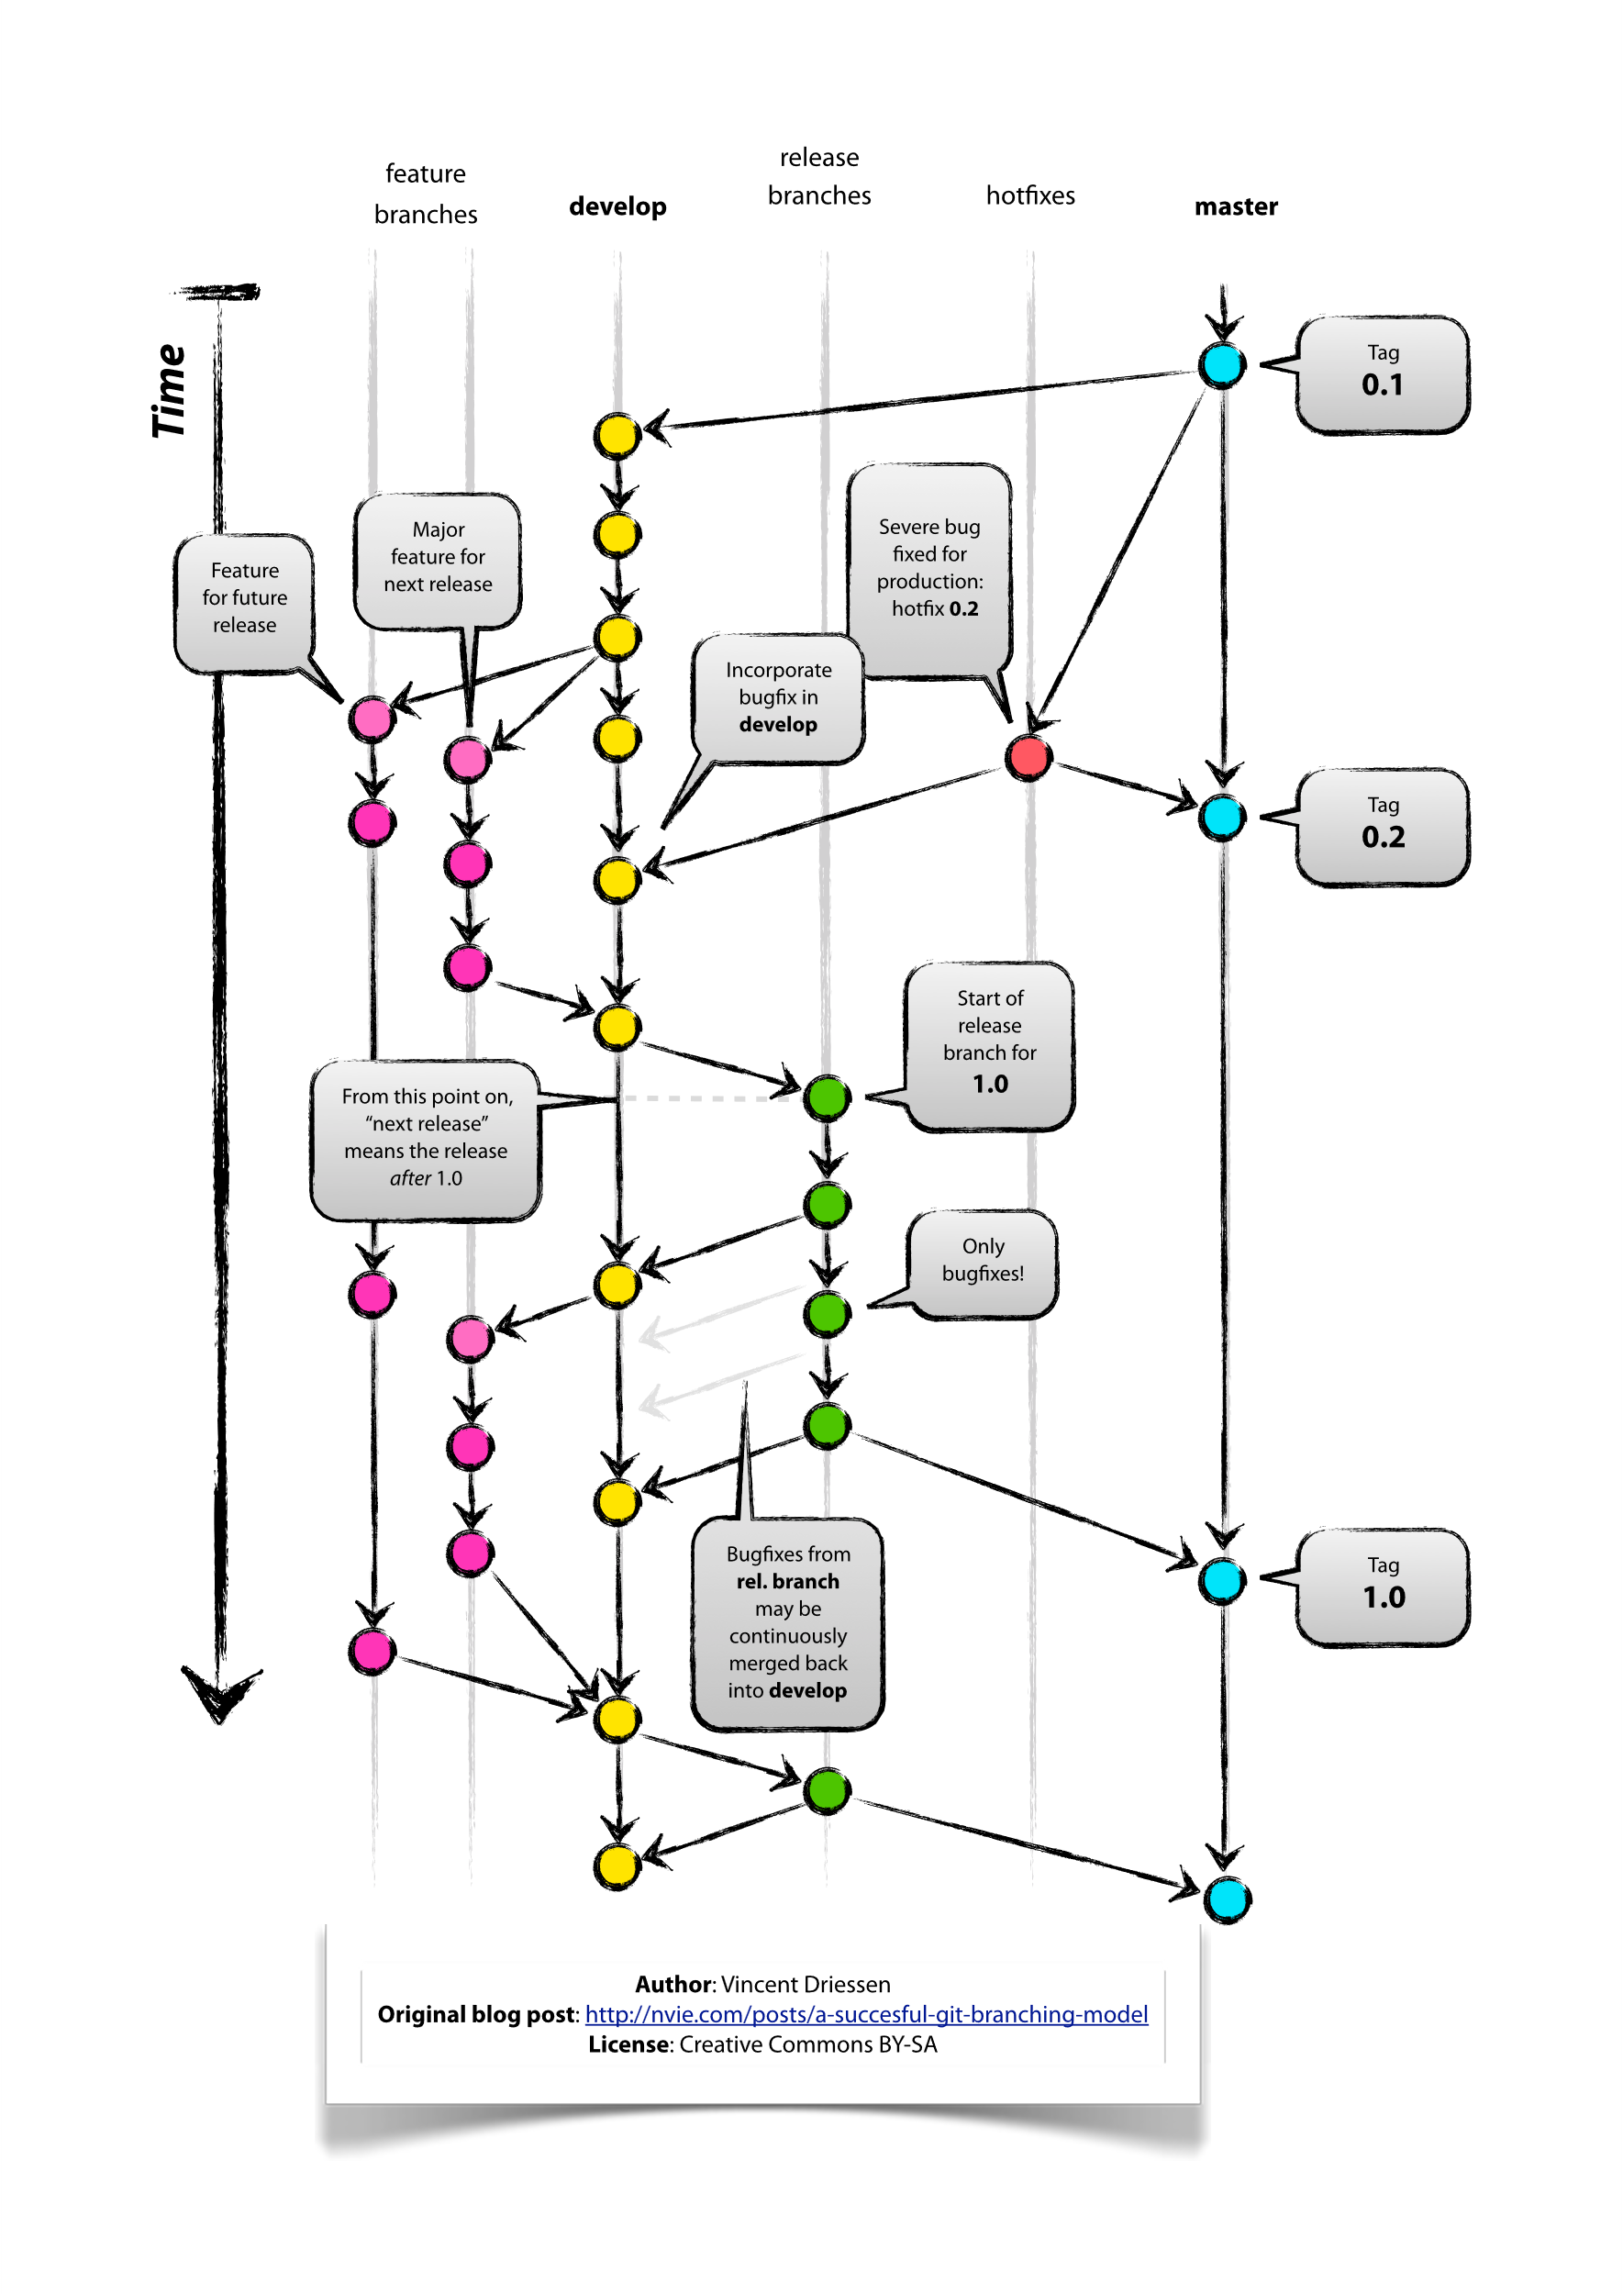
Main Branch
Default branch for finalized code
Created automatically when repo is initialized
Only updated via merges from release/* or hotfix/*
Never commit directly to main
Tag each merge with a release version (v1.0, etc.)
Do not delete this branch
Notes:
main is the official, stable version of the project.
It’s created automatically and should never be edited directly.
Only release or hotfix branches should be merged into it.
Each merge gets a version tag, like v1.0
Never delete main
Some older references may call it master, but we use the modern name: main."

Slide 14
Develop Branch
Created from main
Used to collect finished work from feature/* branches
Also receives updates from release/* after a version is published
Serves as the prep area before official releases
Long-lived — do not delete
Notes:
Created from `main`
Used to collect finished work from `feature/*` branches
Also receives updates from `release/*` after a version is published
Serves as the prep area before official releases
Long-lived — do not delete

Slide 15
Feature Branch
Created from develop
Used for building new features or testing ideas
Each feature gets its own branch (e.g., feature/export-csv)
Merged back into develop when finished
Delete the branch after merging to keep things clean
Notes:
feature/* branches are where you do most of your day-to-day work
You create a feature branch from develop when starting something new
Each feature should get its own branch with a clear name like feature/login-form
Work on it locally, commit regularly, and push your changes
Once it’s complete, you merge it into develop
After merging, delete the branch to keep the repo tidy — the history is still saved
We NEVER use ff – fast forward on a merge
When doing a merge in the command line, the default merge destroys history. To disable this behavior, you have to add parameter --no-ff to every merge. Something similar much be done in the GUI

Slide 16
Hardware Branch
Created from develop for hardware-specific testing
Named based on the test (e.g., hardware/adc-test)
Used for experiments, validation, or debugging
May or may not be merged into develop
Delete after testing is done or changes are ported elsewhere
Notes:
hardware/* branches are for testing on real devices or working through hardware-specific problems
You create them from develop, and name them clearly for what you’re testing
They’re great for isolating debug work or quick experiments without affecting production code
You might keep the changes or you might discard them — it depends on what you learn
If the results are useful, consider moving the changes into a proper feature branch
When the test is done, clean up the branch — the history is still saved in Git

Slide 17
Release Branch
Created from develop when code is ready to release
Each version gets its own branch (e.g., release/v1.0)
Used to finalize version numbers, docs, and bug fixes
Merged into main and tagged with a version
Also merged back into develop
Deleted after release is complete
Notes:
release/* branches are for finishing touches before the code is published
You create one from develop when you're ready to prep a new version
Each release has its own branch named by version — like release/v2.3
Use this branch to clean things up: fix last-minute bugs, update version numbers, and finalize documentation
Once it’s ready, merge it into main — that makes it official
Then, tag the release on main with something like v1.0
You also merge it back into develop to carry over any updates made during the release process
Once both merges are done, delete the release/* branch to keep things organized

